Slide 1


AngularJS: Directives and Controllers
Presented by : Komal Kadam
Email : komalka@cybage.com Extn. 8044A
This document and all its contents contain information from Cybage Software Private Limited which may be privileged, confidential, or otherwise protected from disclosure. The information is intended to be for the addressee(s) only. Any unauthorized disclosure, copy, distribution, or use of the contents of this message is strictly prohibited.

Slide 2
Agenda
HTML Compilers and Directives
Controllers
Example
Best Practices

Slide 3
Recap??

Slide 4
HTML Compilers and Directives :
Angular's HTML compiler allows for the HTML extensibility by enabling us to create custom elements/attributes/classes having custom behaviours.
These Custom Elements are called Directives

Slide 5
HTML Compilers and Directives :
Compiler is an angular service which traverses the DOM looking for elements/attributes/classes. The compilation process happens in two phases.
1) Compile:
Traverse the DOM and collect all of the directives.
The result is a linking function.
2) Link:
Combine the directives with a scope and produce a live view.
User interactions with the view are reflected in the scope model
and vice versa.

Slide 6
Directives:
Directives apply special behaviour to attributes or elements In HTML – Attach behaviour, transform the DOM
Some directives :
– ng-app : Initializes the app
– ng-model : Stores/updates the value of the input field into a variable (It can be applied for input , select and textarea)
– ng-bind : Replace the text content of the specified HTML with the value of given expression:
- ng-repeat : Iterating over object or array. instantiates a template once per item from a collection
– More inbuilt directives: https://docs.angularjs.org/api/ng/directive

Slide 7
Controllers:
Controllers provide the logic behind your app.
– So use controller when you need logic behind your UI
• AngularJS apps are controlled by controllers
• Use ng‐controller to define the controller
Don’t Use controller for DOM manipulations . Add only business logic in angular controllers.
A Controller is a JavaScript constructor function (or a Js Object) that is used to augment the Angular Scope.

Slide 8
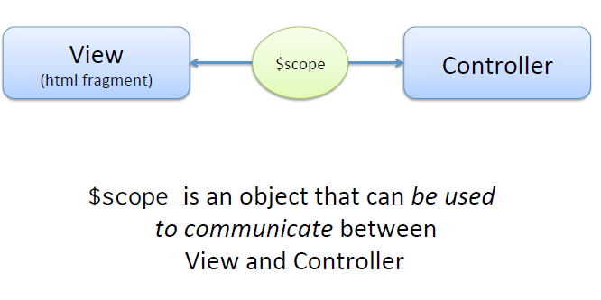
Controllers:
: AngularJS synchronization between View and Controller

Slide 9
Controllers:
How to create one:
module.controller(‘employeeController’, ()=> {
// controller logic goes here
});

Slide 10
Controllers:
How To use it (HTML):
<ANY ng-controller = “ controllerName” >
<ANY>
{{myController.myName}}
</ANY>
</Any>
"Controller as" or "$scope"
EXAMPLES: https://docs.angularjs.org/guide/controller

Slide 11
Example :
Lets have an Example…

Slide 12
Best Practices:
Do’s :
Use to implement logic related to view
Set values in Scope Object
Always use Array syntax of dependency injection
Don’ts:
1) Manipulate DOM - Controllers should contain only view related logic. No direct Dom manipulations should be there.

Slide 13
Best Practices:
Don’ts:
Format input — Use angular form controls instead.
Filter output — Use angular filters instead.
Share code or state across controllers — Use angular services instead.

Slide 14
Any
Questions?

Slide 15
Thank You!

